Slide 1
2023-01-13

Slide 2
7.6.1
Selection Sort

Slide 3
Sorting Algorithms
On Wednesday, we introduced binary search, a search algorithm that only works on sorted arrays.
So, we need to be able to sort arrays. How? With a sorting algorithm!
In Unit 7, we discuss two sorting algorithms: selection sort and insertion sort.
These algorithms are relatively simple... but not very efficient! We will learn a much more efficient algorithm, merge sort, in Unit 9.

Slide 4
Selection Sort
Today, we will just discuss selection sort and you'll implement your own.
We'll cover insertion sort next week.

Slide 5
Selection Sort
Selection Sort is an algorithm that relies on swapping array elements.
We used swapping in section 6.4 to reverse the elements in an array.
Java doesn't have a built-in "swap" capability, so you must use a temporary variable:
Swapping variables is also called exchanging variables. Sort algorithms that rely on swapping/exchanging values are classified as exchange sorts. (Confusingly, there is also a specific sort algorithm called Exchange Sort.)
// Swap array elements array[i] and array[j]
int temp = array[i];
array[i] = array[j];
array[j] = temp;

Slide 6
Selection Sort
For each index i in the array to be sorted:
Find the index j of the minimum value in the range array[i] to array[length-1]
Swap array[i] and array[j] (this is a "no-op" if i == j)

Slide 7
Selection Sort
Let's work through a Selection Sort. We'll start with this unsorted array.
9
13
6
7
1
16
3
12

Slide 8
Selection Sort
Loop Iteration #1
Step 1. Identify minimum value
9
13
6
7
1
16
3
12
Step 2. Swap it into position 0
1
13
6
7
9
16
3
12

Slide 9
Selection Sort
Loop Iteration #2
Step 1. Identify minimum value in array [1..N-1]
1
13
6
7
9
16
3
12
Step 2. Swap it into position 1
1
3
6
7
9
16
13
12

Slide 10
Selection Sort
Loop Iteration #3
Step 1. Identify minimum value in array [2..N-1]
1
3
6
7
9
16
13
12
Step 2. Swap it into position 2
1
3
6
7
9
16
13
12

Slide 11
Selection Sort
Loop Iteration #4
Step 1. Identify minimum value in array [3..N-1]
1
3
6
7
9
16
13
12
Step 2. Swap it into position 3
1
3
6
7
9
16
13
12

Slide 12
Selection Sort
Loop Iteration #5
Step 1. Identify minimum value in array [4..N-1]
1
3
6
7
9
16
13
12
Step 2. Swap it into position 4
1
3
6
7
9
16
13
12

Slide 13
Selection Sort
Loop Iteration #6
Step 1. Identify minimum value in array [5..N-1]
1
3
6
7
9
16
13
12
Step 2. Swap it into position 5
1
3
6
7
9
12
13
16

Slide 14
Selection Sort
Loop Iteration #7
Step 1. Identify minimum value in array [6..N-1]
1
3
6
7
9
12
13
16
Step 2. Swap it into position 6
1
3
6
7
9
12
13
16

Slide 15
Selection Sort
Loop Iteration #8
Step 1. Identify minimum value in array [7..N-1]
1
3
6
7
9
12
13
16
Step 2. Swap it into position 7
1
3
6
7
9
12
13
16

Slide 16

So... Is Selection Sort... Good?

Slide 17
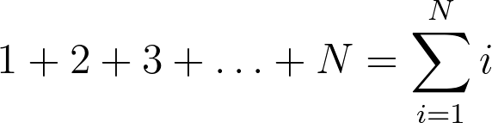
Selection Sort – an intuitive but slow algorithm
Loop # | Comparisons (N=8)
1 | 8
2 | 7
3 | 6
4 | 5
4 | 4
5 | 3
6 | 2
7 | 1
How many comparisons does Selection Sort do?
It examines N elements on the first pass, N-1 elements on the second pass, N-2 on your third… in other words,

Slide 18
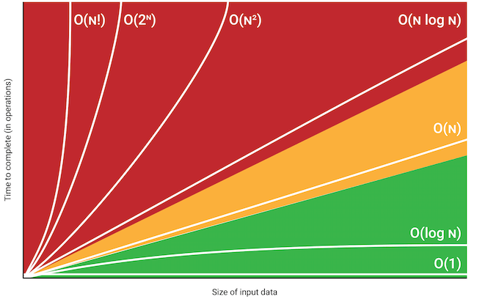
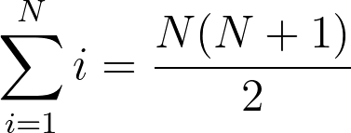
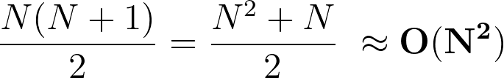
Selection Sort – our old friend O(N²)

Slide 19
Selection Sort – an intuitive but slow algorithm
O(N²) is also known as quadratic time. Many simple sort algorithms are quadratic time.
It can be OK for a small number of elements, but as N gets big, the algorithm's running time becomes very long.
In Unit 10, we will learn a sorting algorithm, merge sort, that has much better running time: O(N log N). But it's also more complicated to code!
N | N²
1 | 1
10 | 100
100 | 10,000
1000 | 1,000,000
10000 | 100,000,000
100000 | 10,000,000,000
1000000 | 10¹²

Slide 20
Flashback: Unit 4.3
In computer science, the computational complexity or simply complexity of an algorithm is the amount of resources required to run it.
Time complexity is the amount of time that an algorithm takes to run, but in an abstract sense of how many operations need to be executed, not a quantity of seconds or milliseconds. The usual units of time (seconds, minutes etc.) are not used because they are too dependent on the choice of a specific computer and on the evolution of technology.
Space complexity is how much memory an algorithm consumes. A lot of our algorithms so far allocate no memory, or allocate one or two things. This is constant space complexity. Constant space complexity means that the amount of space that your algorithm uses is independent of the input parameters. Linear space complexity means you probably allocated an array of size N, or for, quadratic, N^2, etc.
What is the space complexity of Selection Sort?

Slide 21
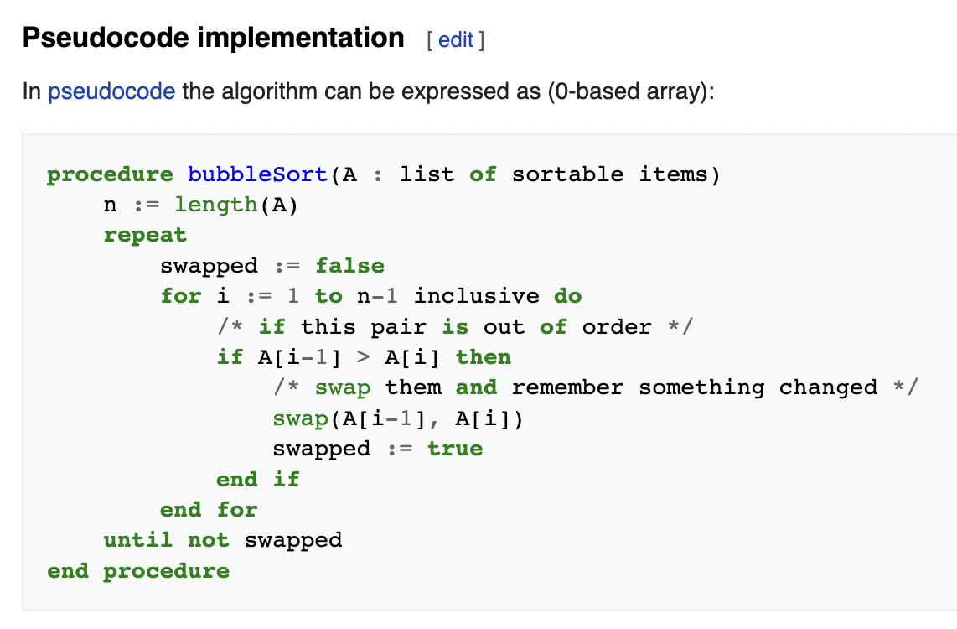
First sorting algorithm I learned: Bubble Sort
Also O(N²). Mostly of historical interest... although bubble sort has some properties that make it useful in some use cases, like computer graphics.

Slide 22
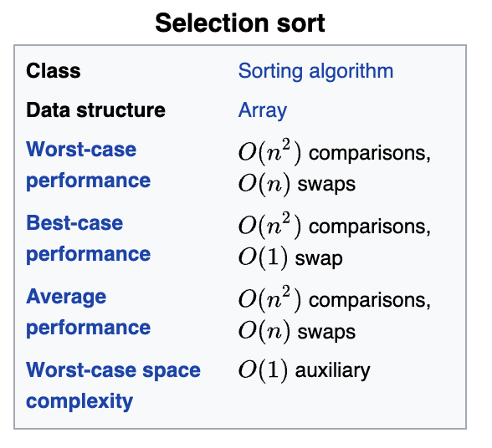
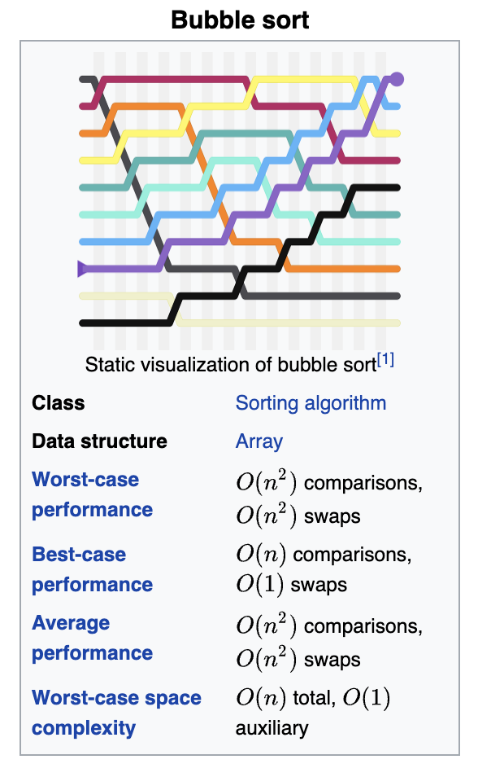
The Jargon File, which famously calls bogosort "the archetypical [sic] perversely awful algorithm", also calls bubble sort "the generic bad algorithm".^{[5]} Donald Knuth, in The Art of Computer Programming, concluded that "the bubble sort seems to have nothing to recommend it, except a catchy name and the fact that it leads to some interesting theoretical problems", some of which he then discusses.^{[6]}

Slide 23
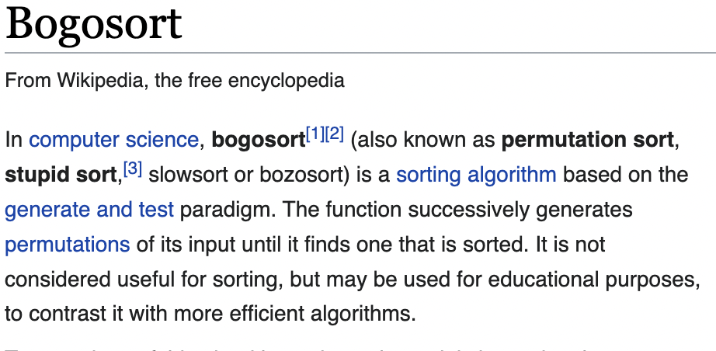
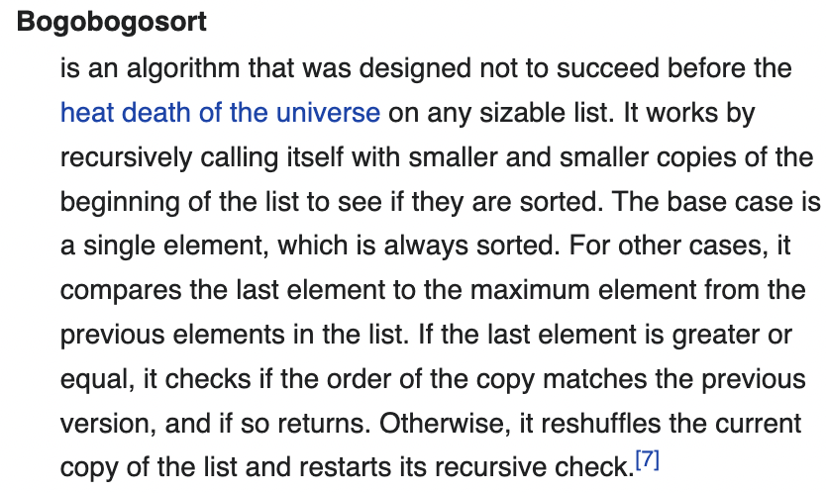
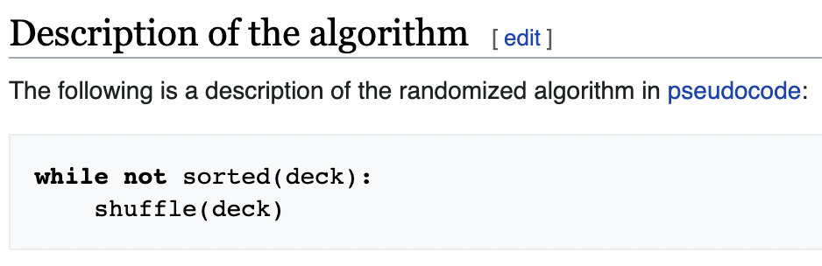

Slide 24
Exercise: Build your own selection sort (not bogosort)
Replit: SelectionSort
We'll reconvene near the end of class to review the solution together.

Slide 25
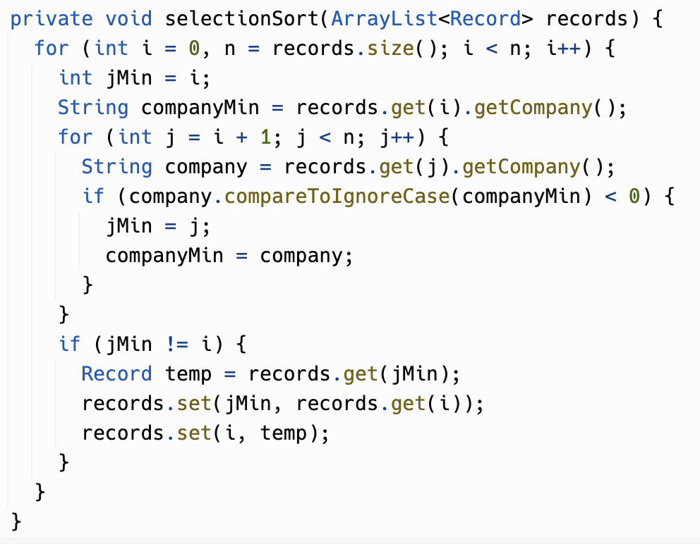

Slide 26
